Slide 1

Submitted By
Azmia Hoque Radhio
ID : 171-35-1932
Section: B
HA
Submitted To
Asif Khan Shakir
Senior Lecturer
Department of Software Engineering
Faculty of Science and Information Technology
Project Tracker Tools

Slide 2

Introduction
In our real-life scenario, we work in many projects or somehow involved in many projects, but in an undisciplined way. We do not maintain our workflow or keep tracks so we cannot see the project overview Or current state we’re in, team collaboration also done in a messy way. So, the project named ‘HAAPEN’ helps us to create projects and associate individuals and distribute tasks or collaborate and keep track, all in one place

Slide 3
Feature List:
Project Manager
Create a plan/project
Create a task boards of the projects
Fixes deadline for the tasks
Commenting with member (issues)

Slide 4
Functional Requirements
A project manager may use the software to map project tasks and visually describe task interactions.
Allows the project manager to create and assign tasks, establish deadlines, and produce status reports.
The software must have the ability to Commenting with member and manager with each other.

Slide 5
Non-functional requirements
Manager must allowed to update their Project information.
Privacy of information, the export of restricted technologies, intellectual property rights, etc. should be audited.
Add a footer

Slide 6
Scope
HAAPEN is a work management solution that enables team collaboration. The project manager use HAAPEN to manage initiatives, create projects, and then to create tasks within these projects to keep everyone in the loop. So again, HAPPEN will save the valuable time of the Project Member and team members by introducing this Project progress tracker.
Add a footer

Slide 7
Assumptions and Constraints
It is assumed that the user is comfortable with computer. The user who are registered must have good knowledge on web surfing.
The user interface is in English as a result people lacking in English skill will face difficulty in using the system. Login and password is used for identification of user and there is no facility for guest.
Add a footer

Slide 8
Dependencies and Risks
The user must have web access in order to use the system.
The main risk behind implementing the project is security. If somebody hacks the system then it will be a total disorder. So during development it will be one of our major concerns.
Another concern is having common bugs such as the Project Member are having the same functionalities as the Supervisor or Project Manager.
Add a footer

Slide 9
Work Flow Status
Web | Android
User Role Based Authentication | Consumes Rest Api
Project manager to create Project | Registration/ Log in
Assign tasks | Build Project
Establish deadlines | Allocate Tasks
Produce status reports | Kanban board
Rest api | Assemble Project status reports
Add a footer

Slide 10
Timescales
Project Task | Start | End | Duration
 |  |  | 7 days | 7 days | 7 days | 7 days | 7 days | 7 days | 7 days | 7 days | 7 days | 7 days | 7 days
Project Proposal & Presentation | 23 Sept | 10 Oct
SRS | 11 Oct | 17 Oct
Designing | 18 Oct | 7 Nov
Coding | 8 Nov | 28 Nov
Testing | 29 Nov | 6 Dec
Finalization | 7 Dec | 13 Dec
Add a footer

Slide 11
Time frames for project implementation
Project Proposal | Azmia Hoque Radhio | 7days
Software Requirement Specification | Azmia Hoque Radhio | 7 days
Software Design | Azmia Hoque Radhio | 21 days
Coding | Azmia Hoque Radhio | 14 days
Software Testing | Azmia Hoque Radhio | 7 days
Project Finalization | Azmia Hoque Radhio | 7 days
Add a footer

Slide 12
Project Resources
Hardware Requirements
Processor | RAM |  | Hard Disk Space
Pentium II or higher | 64 Mb or higher |  | 128 Mb or higher
Software Requirements
Operating System |  | Database
For user no specific OS is required. The server machine must have Windows 7/8/10 along with .NET Core and IIS and For mobile User Android OS is must |  | SQL Server 2019
Add a footer

Slide 13
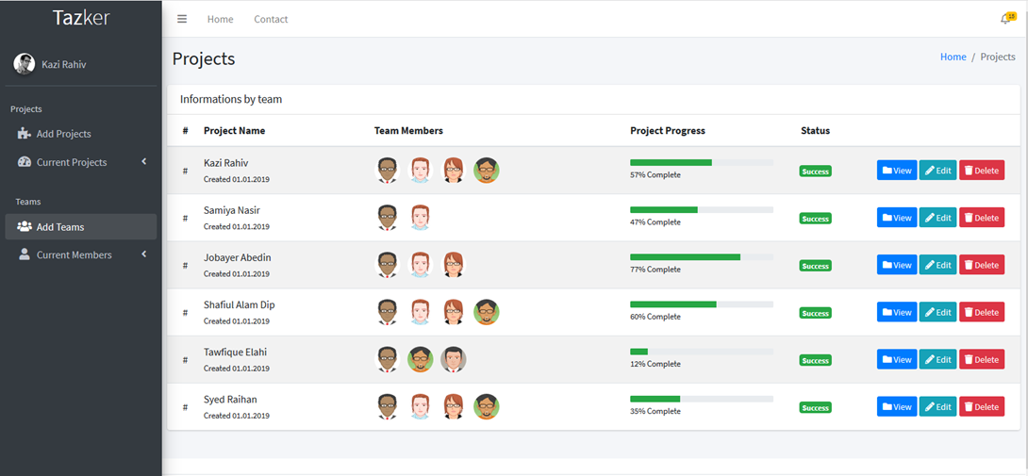
System Images against the Specification for Admin:
Add a footer

Slide 14
Technology:
Client-side : Android JetPack
Server-side: ASP .net core
DBMS : Room Db
Conclusion :
API integration for extending and use information from this application to others.
Mobile application version for managing on the go!
Add a footer

Slide 15
Summary :
Time is our most valuable asset. We cannot waste it when there is scope of utilizing it in a better way. Our proposed system named HAPPEN will be developed to meet this purpose. It will save the time of the mass people wasted during the time of making Proposal submission with the Supervisor. Along with this, HAAPEN will also help the Manage to see the previous records of a Project. As a result s/he can take decisions more wisely. We hope that HAAPEN is destined to do justice to its name.
Add a footer

Slide 16
Thank You.
HA
Azmia Hoque Radhio
HAPPAN
171-35-1932
azmia35-1932@diu.edu.bd
www.radhiopy.com

